Slide 1

MCTS Guide to Microsoft Windows 7
Chapter 12
Disaster Recovery and Troubleshooting

Slide 2
Objectives
Describe the general principles of troubleshooting
Use Windows Backup and Restore to protect user and system components
Describe the major tools used to repair Windows 7
Identify systems and tools that assist in preventative maintenance operations
Review advanced troubleshooting areas

Slide 3
General Principles of Troubleshooting
Troubleshooting
  Process that systematically diagnoses and analyzes a situation to understand why it differs from a desired situation
Once the problem is understood
  Potential solutions can be suggested and investigated

Slide 4
Information Collection
Windows 7 has sophisticated methods to diagnose and repair as many problems as possible
Automated tools in Windows 7 may fix some problems
  But even these tools have limits
First step in efficient troubleshooting
  Collect details that describe the state of the computer and information that describes the problem
Problem Steps Recorder
  Allows users to record the exact steps required to reproduce a problem

Slide 5
Information Collection (cont'd.)
System information
  Scan the current state of the computer and report its findings in a searchable tree format
  Tool can export its findings to a text file or it can be saved to a System Information file
  File can be e-mailed to another technician
Computer Management
  MMC-based utility used to manage several key systems and operations for a computer
  Can also be used to connect to remote computers

Slide 6
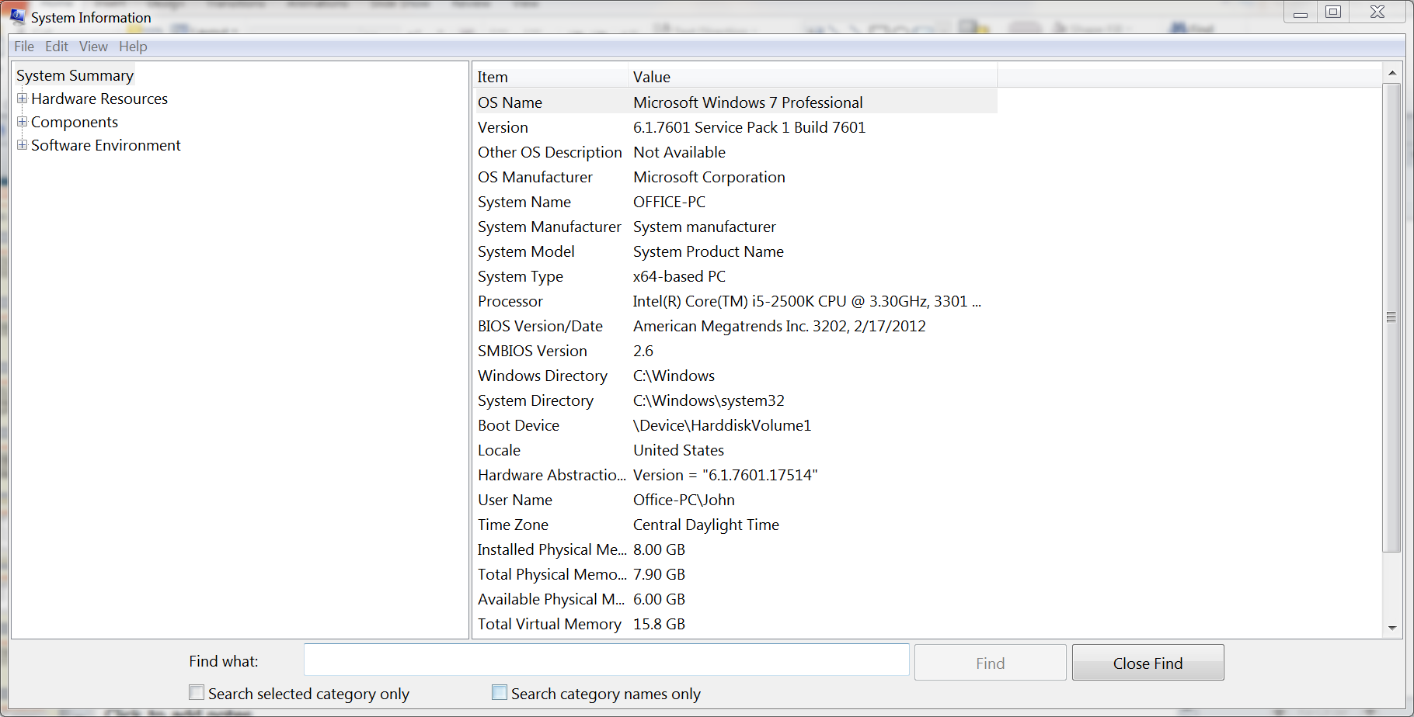
System Information Window

Slide 7
Information Collection (cont'd.)
Computer Management (cont'd.)
  Task Scheduler
    View the recent and current status of tasks that are started automatically
  Event Viewer
    Browse and manage the records of system events and messages stored in system event logs
    Each event log has its own properties

Slide 8
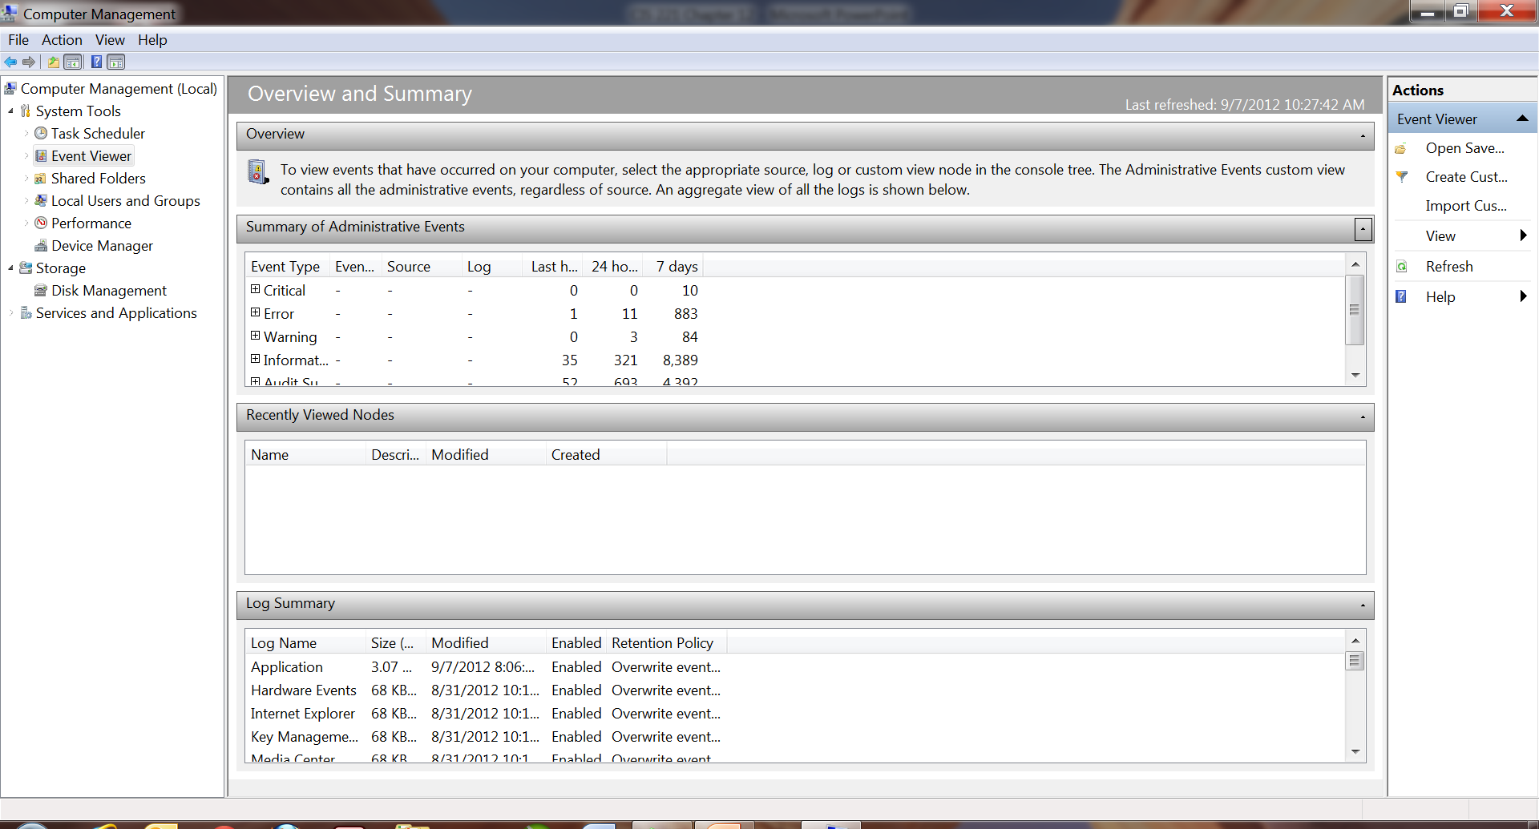
Information Collection (cont'd.)

Slide 9
Information Collection (cont'd.)
Computer Management (cont'd.)
  Event Viewer (cont'd.)
    Data in an event log can be filtered
    Event log filter can be defined separately for each log
    Filter can be edited in XML format by opening a log’s filter and selecting the XML tab
    Custom view
      Presents the same options as an individual filter, but multiple logs or sources can be selected
    Single event in the log can be highlighted in the upper-middle pane
      Details are displayed in the lower-middle pane

Slide 10
Information Collection (cont'd.)
Computer Management (cont'd.)
  Event Viewer (cont'd.)
    Each event includes additional information that is not displayed on the General tab
    Details of a single event can be copied to the Windows clipboard
  Shared Folders identifies:
    What folders are shared on the current computer
    Who is connected to those shared folders
    What files in those shared folders are open

Slide 11
Information Collection (cont'd.)
Computer Management (cont'd.)
  Local Users and Groups
    Identifies the users created on the local computer and the security groups those users belong to
  Performance console
    Used to view real-time performance data or stored performance data from a log file
  Device Manager
    Reports status of currently attached hardware

Slide 12
Information Collection (cont'd.)
Computer Management (cont'd.)
  Disk Management
    Reports the disk configuration of the computer
  Services
    Presents controls and reports the state of installed services that can be managed from this user interface
    Services run as a process in the background
      Within a session restricted from the user’s own session for security isolation
    Properties of a service can be modified
      By selecting a specific service in the Services console and selecting Properties

Slide 13
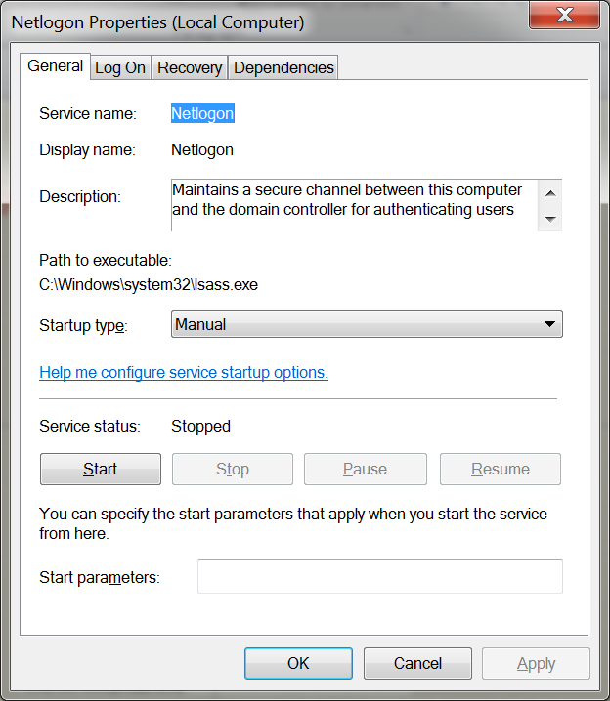
Netlogon Properties Dialog Box

Slide 14
Information Collection (cont'd.)
Computer Management (cont'd.)
  Services (cont'd.)
    Operates as an application in its own secured session
      With the security credentials defined on the Log On tab of the service’s properties
    Services that fail or crash may be configured to restart based on the settings found on the Recovery tab
    Service can be experiencing errors or issues
      Due to the effect of other services it depends on that are having problems

Slide 15
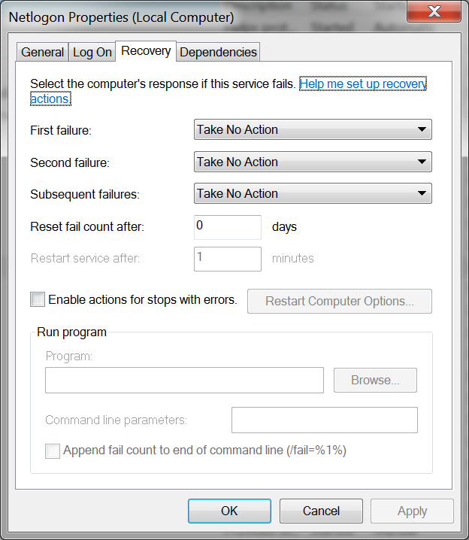
Netlogon Properties Dialog Box

Slide 16
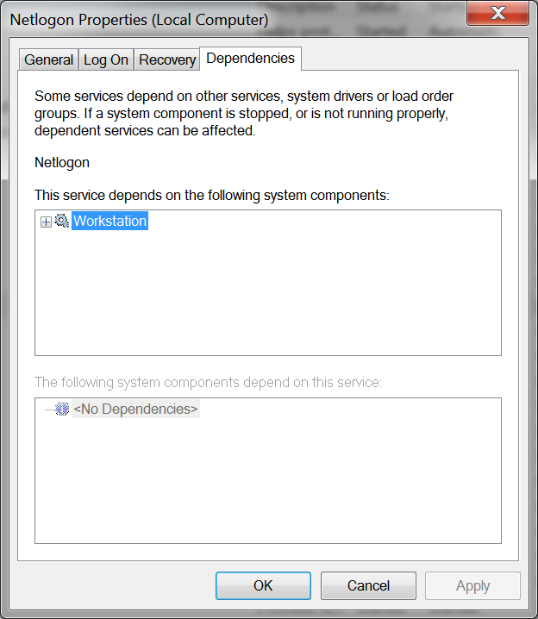
Netlogon Properties Dialog Box

Slide 17
Information Collection (cont'd.)
Computer Management (cont'd.)
  WMI Control
    Configures and controls the Windows Management Instrumentation (WMI) service
    WMI allows management systems to interact with agent software running as part of Windows operating system
Action Center
  Single location where you can identify and address any security issues, maintenance requirements, and errors that have arisen

Slide 18
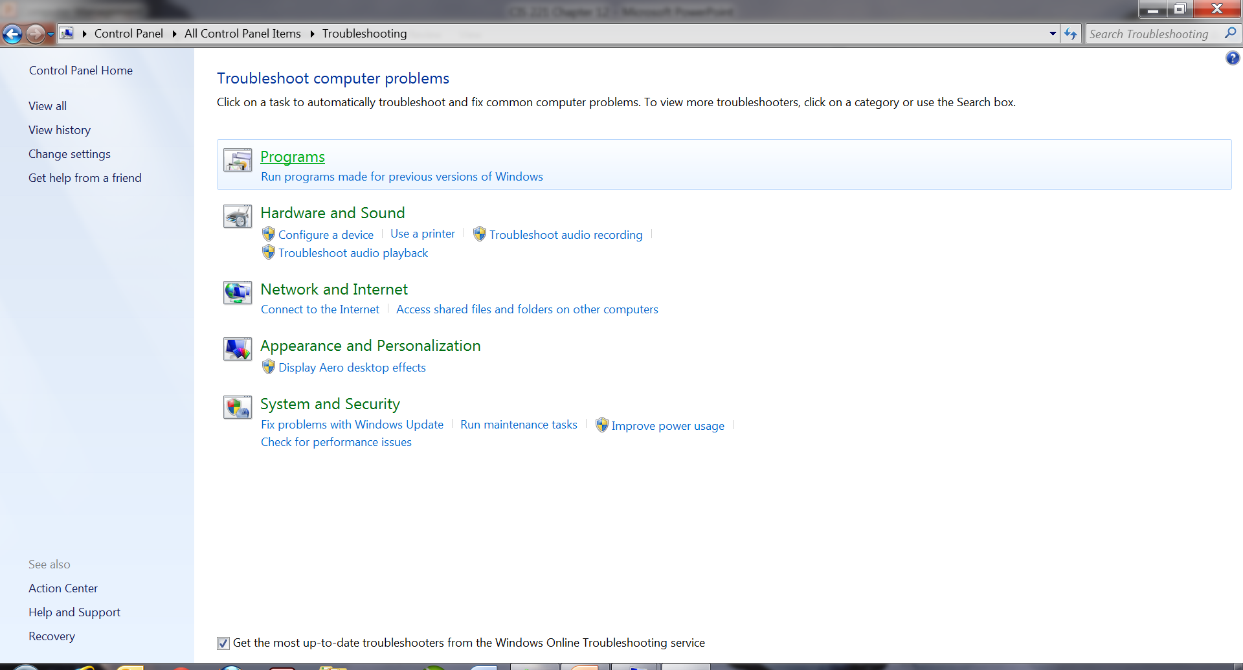
Troubleshooting Window

Slide 19
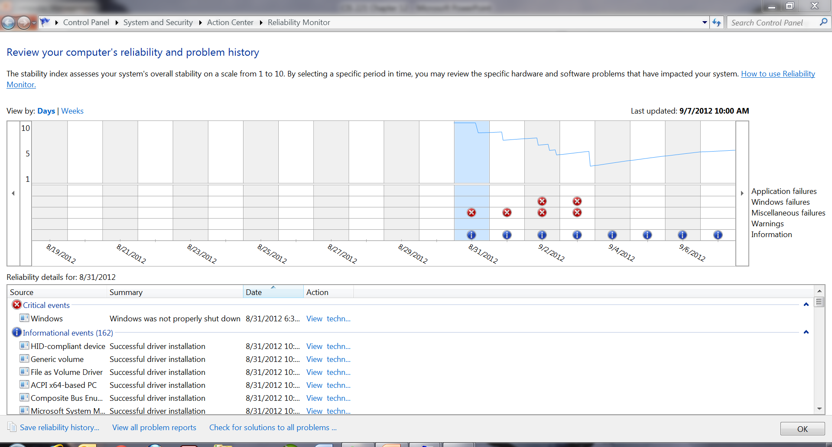
Reliability Monitor

Slide 20
Information Collection (cont'd.)
Help and Support
  Available from the Start Menu
  Useful research tool to source troubleshooting advice
Microsoft Support Web Site
  http://support.microsoft.com
  Common knowledge base provided with searchable articles describing problems and suggested solutions
  Each knowledge base article is assigned an article number that is usually prefaced with the letters KB

Slide 21
Solution Guidelines
Common solution guidelines
  Be patient
  Familiarize yourself with the involved hardware and software
  Limit changes
  Confirm recent changes
  Attempt to isolate the problem
  Identify past problem areas
  Try the easy and quick fix first
  Focus on the main problem area
  Profile the failure
  Log problems and attempted solutions
  Learn from mistakes
  Ask for help
  Experiment

Slide 22
Windows Backup and Restore
When data is lost, the only way to recover it may be from a backup copy
Windows 7 includes Backup and Restore
  Provides user the ability to back up files, restore files, create a system image, and create a system repair disc

Slide 23
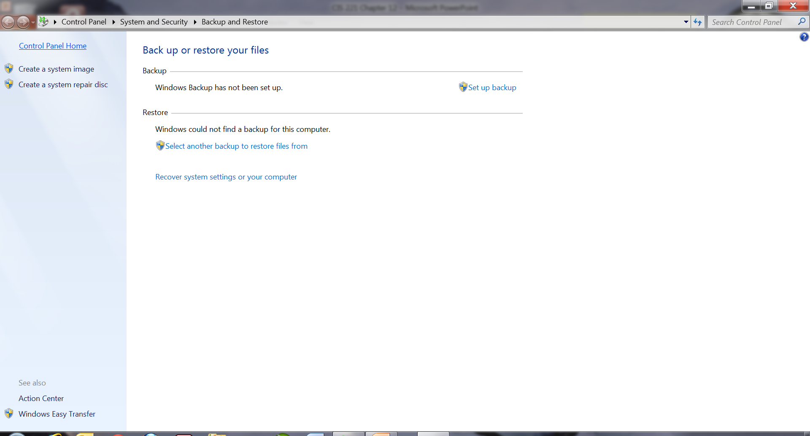
Windows Backup Utility Window

Slide 24
File Backup
Windows backup
  Designed to back up data files for all people who use the computer
When a user first clicks on Set up backup, the Set up backup wizard is started
  Wizard asks where backup data will be saved
Wizard asks user to select the types of data
Can schedule periodic back up

Slide 25
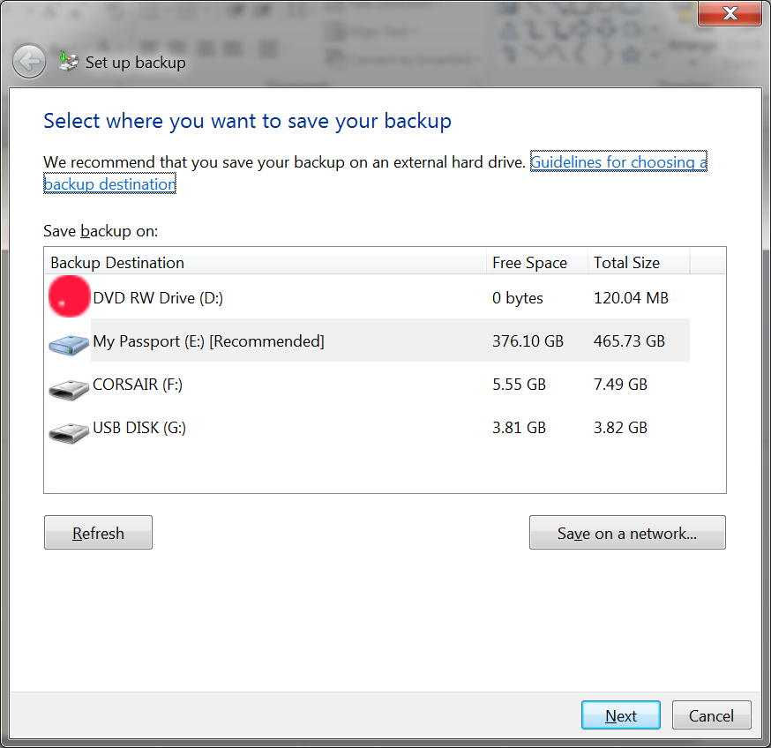
Backup Setup

Slide 26
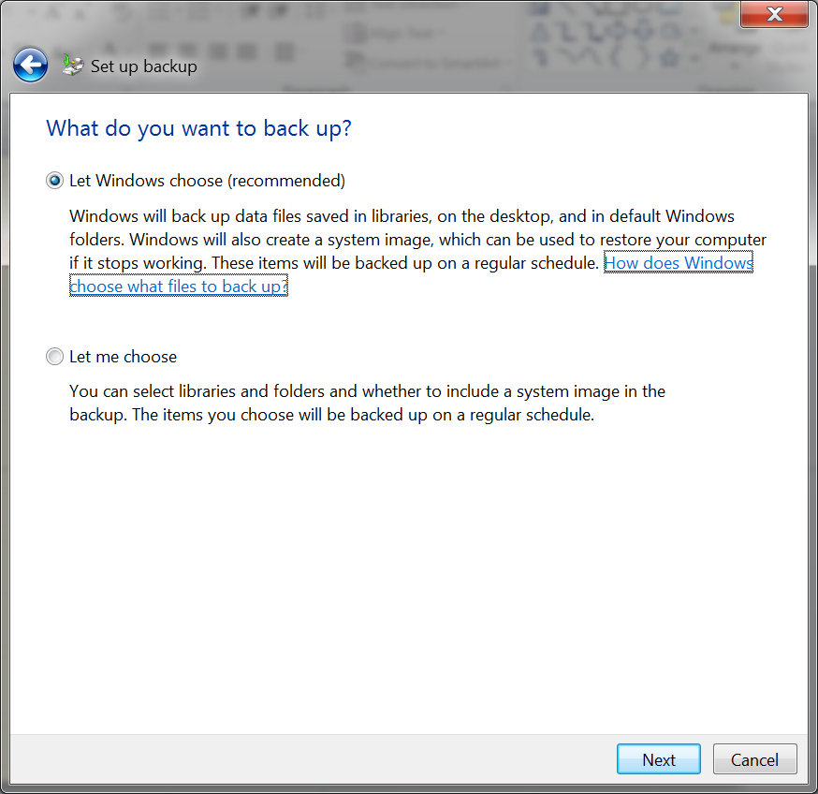
Backup Setup

Slide 27
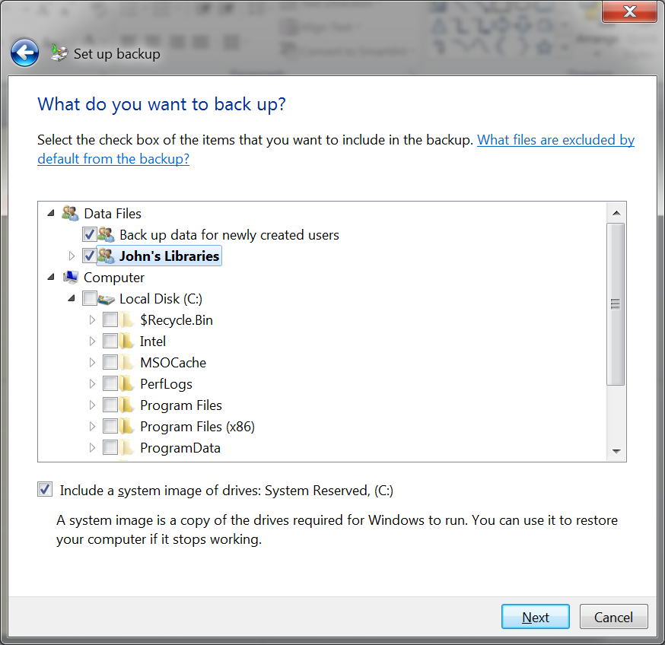
Backup Setup

Slide 28
File Backup (cont'd.)
Backed-up files are stored in the target location using a complex folder structure
  Identifies computer, date, and time of backup
Compressed files store the collected data
  Maximizes backup location’s storage space
Backup folder structure is not to be browsed directly

Slide 29
Restore Files
Backup and Restore utility has an option to restore files
Restore files window
  Offers you the ability to Search, Browse for files, or Browse for folders that need to be restored
Files and folders can be added to the list of what data to restore
Restore File wizard asks where the recovered data should go

Slide 30
Create a System Image
Create a system image wizard
  Creates a complete image of the computer
    Allows the operating system, applications, data, and custom settings to all be restored at one time
  Accessible through the Backup and Restore tool
  System can be restored in three ways
  Scan for devices capable of backing up the image
Image data stored as virtual hard disk image (.VHD)

Slide 31
Repairing Windows 7
Primary tools used to diagnose and repair Windows 7
  Advanced Boot Options Menu
  System Restore
  Device Driver Rollback
  Windows Recovery Environment
  Automatic Repairs

Slide 32
Advanced Boot Options Menu
When the computer is started
  Can detect if the computer was not shut down properly
  Advanced Boot Options menu displayed automatically
To open this menu manually
  Computer must be restarted and the F8 function key must be pressed before the Windows Logo appears
Safe Mode
  Limited functionality, troubleshooting startup mode

Slide 33
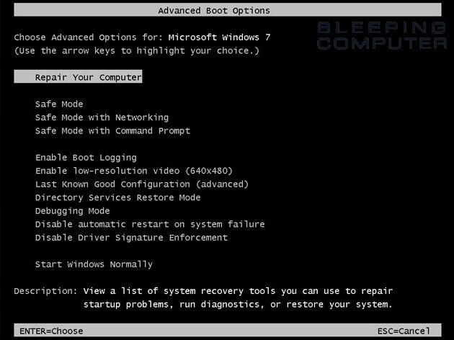
Advanced Boot Options Menu (cont'd.)

Slide 34
Advanced Boot Options Menu (cont'd.)
Safe Mode (cont'd.)
  Authentication is still required to log in
  Extra applications do not run
  Active hardware device drivers are restricted as well
  Not all of the system services are enabled
    Networking system is not considered essential
Safe Mode with Networking
  Limited networking components are enabled
  Not designed to support all networking features
  Can connect to remote computers

Slide 35
Advanced Boot Options Menu (cont'd.)
Safe Mode with Command Prompt
  Many command-line tools can be used to modify or review the state of the computer
  Avoids graphical environment
  Can roll back to an earlier system restore point
Last Good Known Configuration
  If no suitable restore point to roll back to and the computer recently started without problems
    Last Known Good configuration might restore functionality

Slide 36
Advanced Boot Options Menu (cont'd.)
Other advanced boot options
  Enable Boot Logging
  Enable low resolution video (640×480)
  Directory Services Restore Mode
  Debugging Mode
  Disable automatic restart on system failure
  Disable Driver Signature Enforcement
  Start Windows Normally

Slide 37
System Restore
System Restore
  Can return operating system to previously saved state
    By reversing changes to Windows system files, the registry, and newly installed software
  Does not guarantee reversal of all changes
Restore point: snapshot computer state
  Saved on disk that holds the original copy of the data

Slide 38
System Restore (cont'd.)
Space used on a disk to collect restore point data can be adjusted
System Protection tab of the System Properties window allows the user to:
  Manually create a new restore point
  Select which disks are scanned for restore point data
  Trigger the System Restore wizard to revert to a previously saved restore point
When the system is restored to a previous restore point, the current system state is saved first

Slide 39
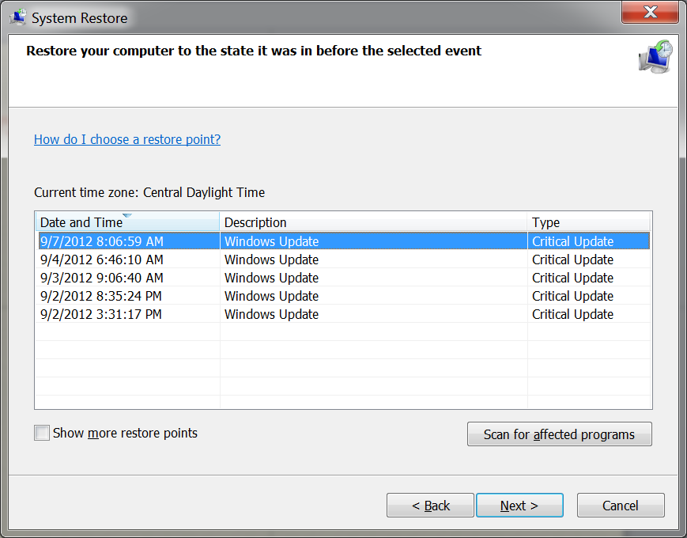
System Restore Window

Slide 40
Device Driver Rollback
Device driver can be rolled back
Start Device Manager and select the properties of the problem device
From the Driver tab, click the Roll Back Driver button to restore the device driver to a prior version

Slide 41
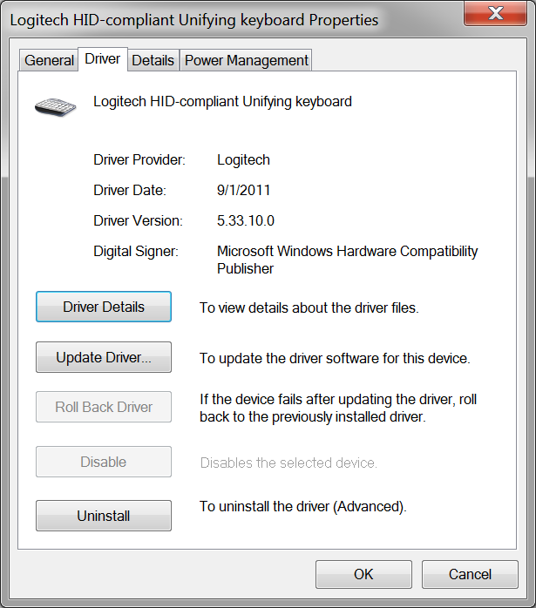
Device Driver Rollback (cont'd.)

Slide 42
Windows Recovery Environment
To start the Windows Recovery environment, manually boot from the Windows 7 DVD
Select the option Repair your computer
Scans for installed operating systems to fix
System Recovery Center menu is displayed
Startup Repair Tool
  Used to recover a Windows 7 installation
  Automatically fixes problems
  Contains built-in intelligence that can examine the operating system files, logs, and settings automatically

Slide 43
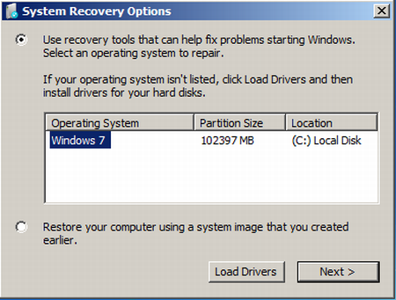
Windows Recovery Environment (cont'd.)

Slide 44
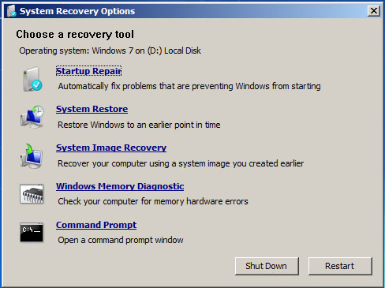
Windows Recovery Environment (cont'd.)

Slide 45
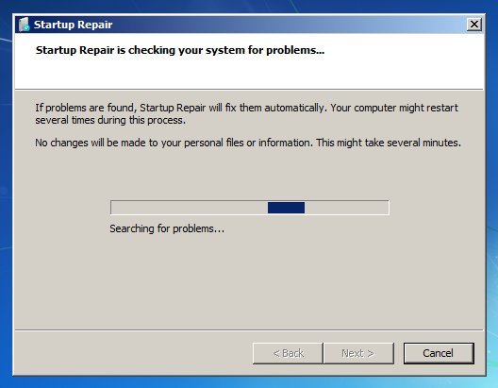
Windows Recovery Environment (cont'd.)

Slide 46
Windows Recovery Environment (cont'd.)
Startup Repair Tool (cont'd.)
  Designed to report on what it believes is the root cause of any boot failure
System Restore
  Allows the computer state to be rolled back to a previous restore point
System Image Recovery
  Allows the computer’s operating system to be restored from an image
    Created earlier with the Windows Backup and Restore utility

Slide 47
Windows Recovery Environment (cont'd.)
Windows Memory Diagnostic
  Designed to detect memory (RAM) that is not operating correctly
  Cannot run from within Windows 7
  Type of tests that can be selected are basic, standard, and extended
  Number of passes can be set as an option
    One pass usually sufficient to detect a failure in memory
  Memory is treated as a system, not a single component

Slide 48
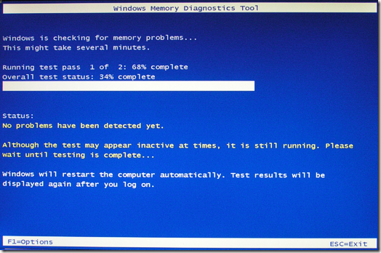
Windows Recovery Environment (cont'd.)

Slide 49
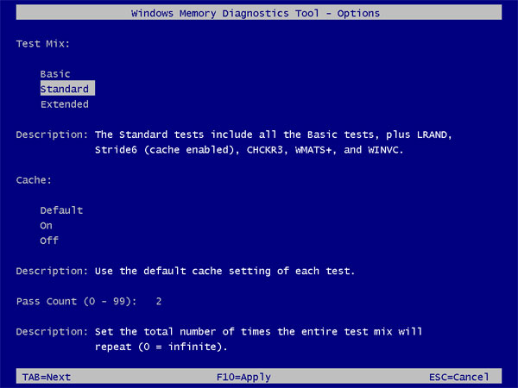
Windows Recovery Environment (cont'd.)

Slide 50
Windows Recovery Environment (cont'd.)
Command prompt
  Allows command-line utilities to be used by the advanced IT administrator in repairing the computer

Slide 51
Automatic Repairs
Windows 7 can automatically detect, self-diagnose, and attempt repairs for many common causes of crashes and hangs
If a problem is suspected, Windows 7 attempts to work around the issue
Automated and advanced tools help diagnose startup, memory, hard disk, and networking issues

Slide 52
Automatic Repairs (cont’d.)
Network Diagnostics Wizard
  Network Diagnostics tool
    Uses a built-in decision tree to determine a likely cause and a best course of remedial action
  If a problem is detected by Windows programs
    Network Diagnostics wizard may start automatically and offer to diagnose and repair the problem
  Network Diagnostics wizard may find a likely error and suggest a remedial action

Slide 53
Automatic Repairs (cont’d.)
Hard Disk Diagnostics
  Device drivers responsible for communicating with the disk hardware
    Can report hard disk problems and defects to the operating system
  Windows 7 prompts user to take proactive actions

Slide 54
Preventative Maintenance
Windows 7 is reliable if:
  It is not modified by non-Microsoft software updates
  It is patched with necessary updates from Microsoft
Windows 7 guarantees these points with Windows File and Resource Protection and Windows Update

Slide 55
Windows Resource Protection
Windows File Protection
  Protects operating system files so they would not be replaced with incompatible versions
Windows Resource Protection
  Protect critical operating system files and registry keys
    By restricting permissions to these resources
Protected files can only be modified by the TrustedInstaller service

Slide 56
Advanced Troubleshooting
This section reviews the DirectX diagnostic testing tool and the Windows 7 boot process

Slide 57
DirectX Diagnostic Testing
Windows 7 supports a rich graphical environment
Many games and media applications are written to use the DirectX programming
  Allows those applications to interact with sound, video, and input devices
Windows 7 provides a DirectX diagnostic tool for user-based testing
  Located in %SystemRoot%\System32 and named DXDIAG.EXE

Slide 58
Windows 7 Boot Process
Basic Input Output System (BIOS)
  Acts as an interface between hardware and the operating system
  Embedded within the motherboard
Operating system is written to communicate with the BIOS rather than standard hardware
One limitation is the requirement for a 16-bit real-mode interface
United Extensible Firmware Interface (UEFI)
  New standard for firmware that can support additional processors such as Itanium

Slide 59
Windows 7 Boot Process (cont'd.)
Boot components
  Bootmgr
  Boot configuration data
  Winload.exe
  Winresume.exe
Boot process modification
  Tools you can use to modify the boot process
    Startup and Recovery
    System Configuration
    BCDEdit
    Windows Management Interface (WMI)

Slide 60
Windows 7 Boot Process (cont'd.)
Master boot record is loaded from hard drive
Master boot record loads the active partition
Booting is started form the active directory
Booting reads the BDC and processes the boot menu
Booting loads Winload.exe
Winload.exe loads the kernel and the HAL
The kernel starts and loads the remainder of the operating system

Slide 61
Summary
Several tools provide detailed information about what is happening with a computer
Solution guidelines provide a basis for a common sense approach to troubleshooting problems
Windows Backup and Restore utility helps protect user data before a loss occurs
Windows 7 includes several methods to repair Windows 7

Slide 62
Summary (cont'd.)
The Windows Recovery Environment can:
  Run the Startup Repair tool
  Restore a Complete PC Backup
  Roll back system state to a prior restore point
  Run the Windows Memory Diagnostic
  Run a command prompt for low-level diagnostic commands
Windows 7 protects operating system files with Windows File and Resource protection
Advanced troubleshooting includes DirectX diagnostic tool and Windows 7 boot process

